Slide 1
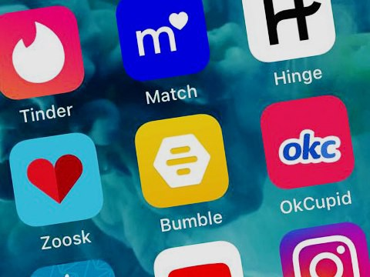
Exploratory Analysis of Dating Applications
Team Members: Ramiro Cervantes, Paola Moreno, Estela Perez

Slide 2
Background
Covid-19 pandemic affected the way people interacted with one another. Being that the pandemic forced everyone to isolate, not only by mandate, but also by fear of contracting the infection by human contact; people who were looking for courtship began accepting different ways to socialize. Many people turned to dating applications which became more commonly accepted platforms during the pandemic, where they socially connected without any fears of becoming infected.

Slide 3
Thesis
Our project will analyze the dating pool within the dating apps Tinder, Hinge and OkCupid. We will provide a summary of demographic data, including, age, race, sex and economic characteristics. We will also be comparing the ratings and “success” rates of the apps to determine their efficiency. Research Questions

Slide 4
What does the online dating pool look like?

Slide 5
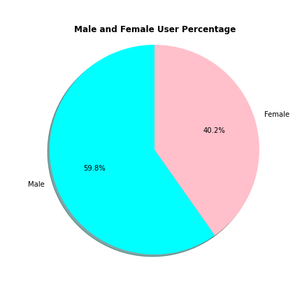
Gender

Slide 6
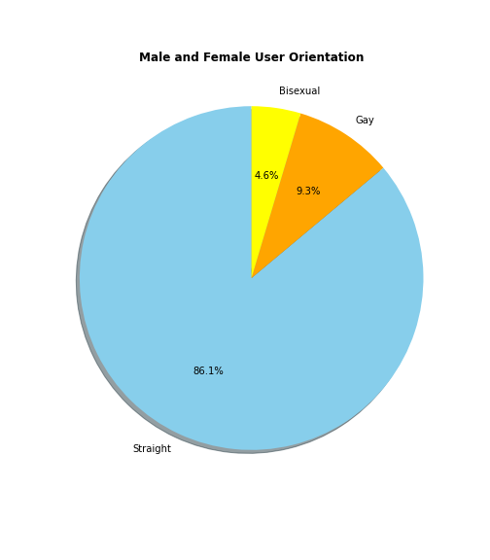
Sexual Orientation

Slide 7
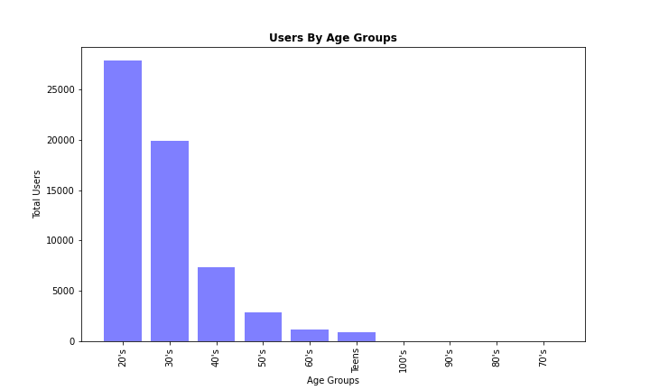
Age

Slide 8
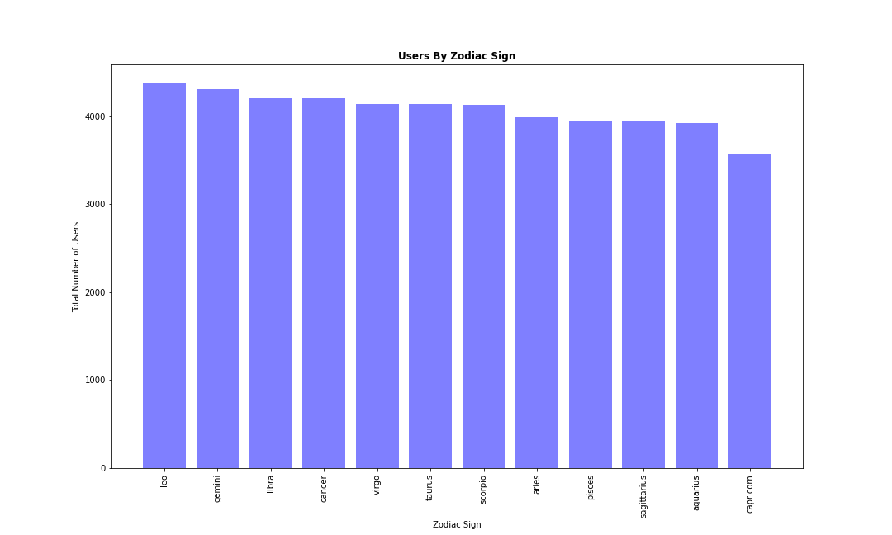
Zodiac Sign

Slide 9
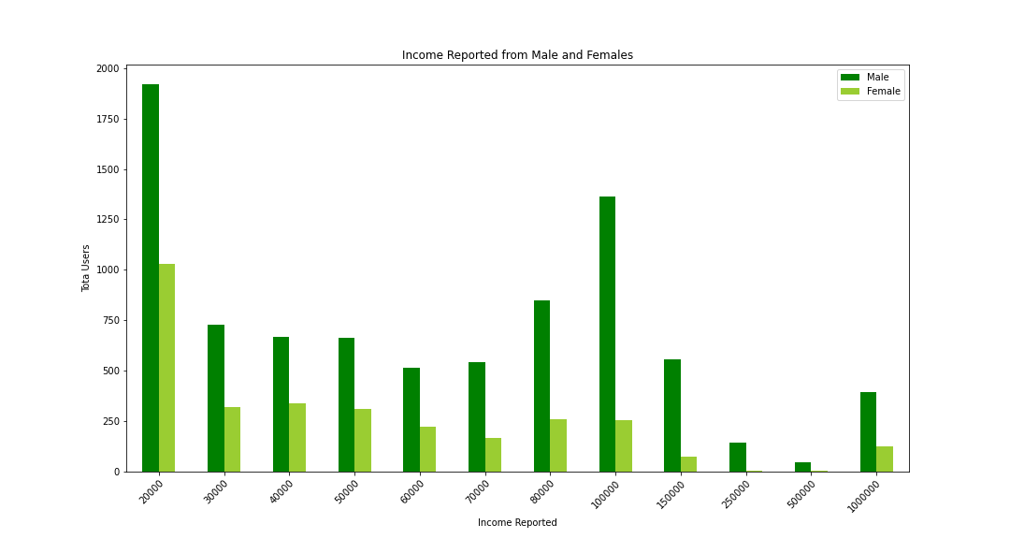
Income

Slide 10
When comparing OkCupid, Tinder, and Hinge, which app is the best rated?

Slide 11
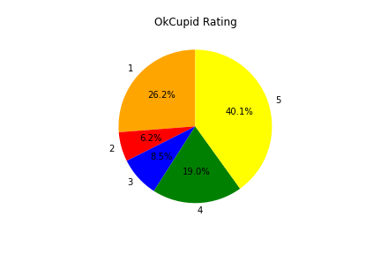
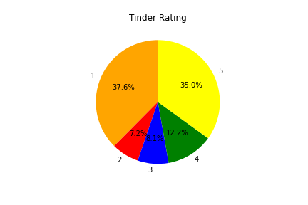
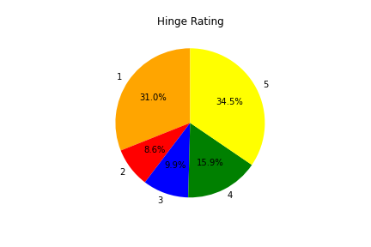
(1-5) Star ratings form the Google Play Store reviews as of May 2022

Slide 12
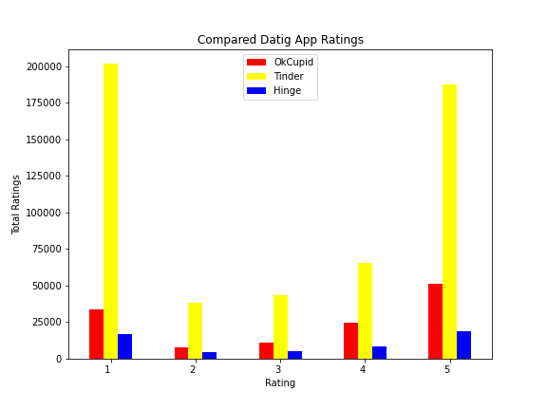

Slide 13
How successful are these apps?

Slide 16
Has there been a change in the companies grows due to the pandemic?

Slide 19
Conclusion

Slide 20
Links
Datasets
OkCupid Profiles | Kaggle
Tinder Dating App - Google Play Store Review | Kaggle
Hinge Dating App - Google Play Store Review | Kaggle
OkCupid Dating App - Google Play Store Reviews | Kaggle
Tinder Millennial Match Rate | Kaggle
API
Free Stock APIs in JSON & Excel | Alpha Vantage

